Slide 1
Access restriction schemes
Technical workshop "Urban Mobility Package"
Brussels, 13th June 2013
Mark MAJOR
DG MOVE
Unit C1 : Clean Transport and Sustainable Urban Mobility

Slide 2
Scope of Initiative 32
EU Framework for Urban Road User Charging and Access Restriction Schemes (ARS)
- Review effectiveness of ARS
- Identify existing barriers to implementation
- Assess impacts of current lack of harmonisation
- Assess potential of ARS on introduction of clean vehicles
- Policy/strategy recommendation for EU framework
- Identify minimum standards

Slide 3
Definition of “Access Restriction Schemes”
Case studies with ARS/road user charging:
Urban Access Restriction (ISIS/PWC, 2009)
CURACAO Deliverable D3 (2009)
Urban Aspects of Internalisation of External Costs (Ecorys/CE, 2012)
CIVITAS Initiative (I, II and Plus)
Urban Freight Transport (MDS, 2012)
Additional information from several cities (Milan, Amsterdam, etc.)
Any comments on the definition of an ARS ?
“Any policy measure implemented to manage the demand for access
for certain or all road vehicles to an urban area”

Slide 4
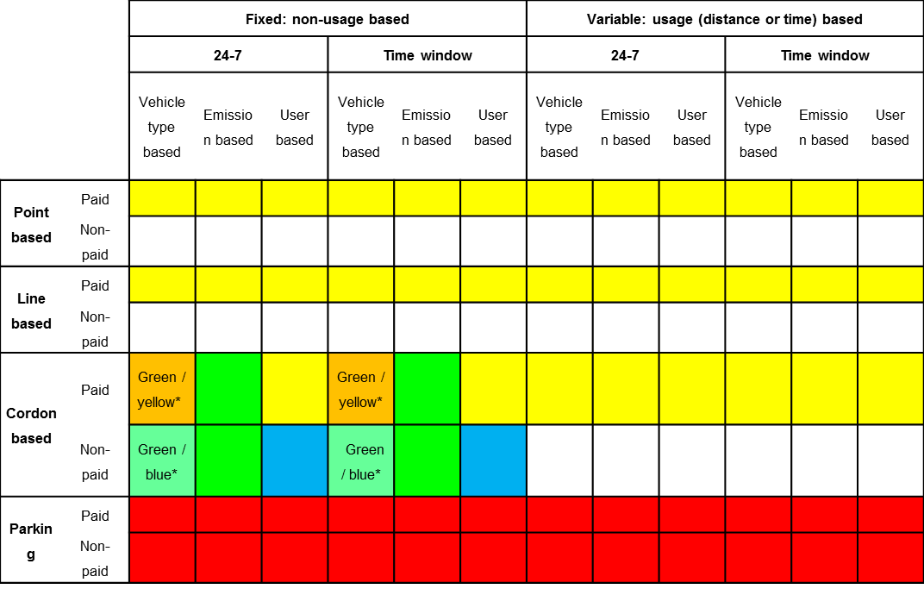
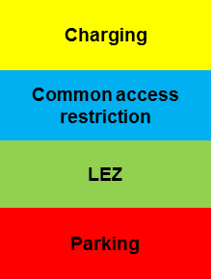
From a wide range of measures to an ontology
Any comments on this ontology?

Slide 5
General conclusions on ARSs II
No harmonised systems of ARS, incurring substantial societal costs
Inadequate practices on evaluation (data and methodologies)
No information system of sharing best practices (esp on Parking)
Given the many local specificities EU’s role should be focused on a limited number of issues, removing the main causes of inefficiencies in the current system

Slide 6
General conclusions on ARSs VIII
Harmonisation brings benefits: what to harmonize?
We conclude that harmonisation is most important in :
emission norms
technology use (for example access technologies, such as stickers/On-Board Units/GPS/other, payment modes, IT platforms, etc)
information provision, common language
establishing standards for monitoring and evaluation methodologies

Slide 7
Policy questions/
1) How could the EU level facilitate a more harmonised development of ARS by local authorities?
2) Would you support EU harmonisation of:
(i) Emission norms
(ii) Technology
(iii) Information provision
(iv) Evaluation methodologies
3) Are there other aspects where EU harmonisation would have significant benefits?
4) Are ARS a necessary element to be addressed in a SUMP framework?

